Slide 1
Distribution Automation Equipment

Slide 2
Modern electric power systems are supplied by large central generators that feed power into a high voltage interconnected transmission network.
The power, often transmitted over long distances, is then passed down through a series of distribution transformers to final circuits for delivery to customers

Slide 4
Operation of the generation and transmission systems is monitored and controlled by Supervisory Control and Data Acquisition (SCADA) systems.
These link the various elements through communication networks (for example, microwave and fibre optic circuits) and connect the transmission substations and generators to a manned control centre that maintains system security and facilitates integrated operation

Slide 5
. In larger power systems, regional control centres serve an area, with communication links to adjacent area control centres.
In addition to this central control, all the generators use automatic local governor and excitation control.
Local controllers are also used in some transmission circuits for voltage control and power flow control, for example, using phase shifters (sometimes known as quadrature boosters)

Slide 6
Traditionally, the distribution network has been passive with limited communication between elements. Some local automation functions are used such as on-load tap changers and shunt capacitors for voltage control and circuit breakers or auto-reclosers for fault management.
These controllers operate with only local measurements and wide-area coordinated control is not used.

Slide 7
The connection of large intermittent energy sources and plug-in electric vehicles will lead to an increase in the use of Demand-Side Integration and distribution system automation.

Slide 8
Substation automation equipment
The components of a typical legacy substation automation system are shown in Figure 6.2.
Traditionally, the secondary circuits of the circuit breakers, isolators, current and voltage transformers and power transformers were hard-wired to relays.
Relays were connected with multi-drop serial links to the station computer for monitoring and to allow remote interrogation

Slide 10
The station level includes the substation computer, the substation human machine interface (which displays the station layout and the status of station equipment) and the gateway to the control centre.
The bay level includes all the controllers and intelligent electronic devices (which provide protection of various network components and a real-time assessment of the distribution network).
The process level consists of switchgear control and monitoring, current transformers (CTs), voltage transformers (VTs) and other sensors.

Slide 12
In connection 1, analogue signals are received from CTs and VTs (1 A or 5 A and 110 V) as well as status information and are digitised at the bay controller and IEDs
In connection 2, analogue and digital signals1 received from CTs and VTs are digitised by the interfacing unit. The process bus and station bus take these digital signals to multiple receiving units, such as IEDs, displays, and the station computer that are connected to the Ethernet network.

Slide 13
In connection 1, analogue signals are received from CTs and VTs (1 A or 5 A and 110 V) as well as status information and are digitised at the bay controller and IEDs

Slide 14
In connection 2, analogue and digital signals1 received from CTs and VTs are digitised by the interfacing unit.
The process bus and station bus take these digital signals to multiple receiving units, such as IEDs, displays, and the station computer that are connected to the Ethernet network.

Slide 15
To increase reliability, normally two parallel process buses are used (only one process bus is shown in Figure 6.3) [5].

Slide 16
The station bus operates in a peer-to-peer mode. This bus is a LAN formed by connecting various Ethernet switches through a fibre-optic circuit. The data collected from the IEDs is processed for control and maintenance by SCADA software that resides in the station computer.

Slide 17
The hard-wiring of traditional substations required several kilometres of secondary wiring in ducts and on cable trays. This not only increased the cost but also made the design inflexible.
In modern substations as inter-device communications are through Ethernet and use the same communication protocol, IEC 61850, both the cost and physical footprint of the substation have been reduced.

Slide 18
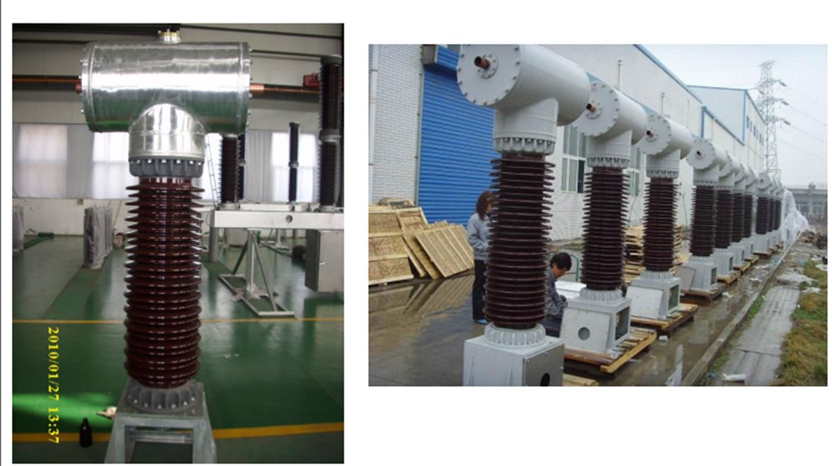
CT

Slide 19
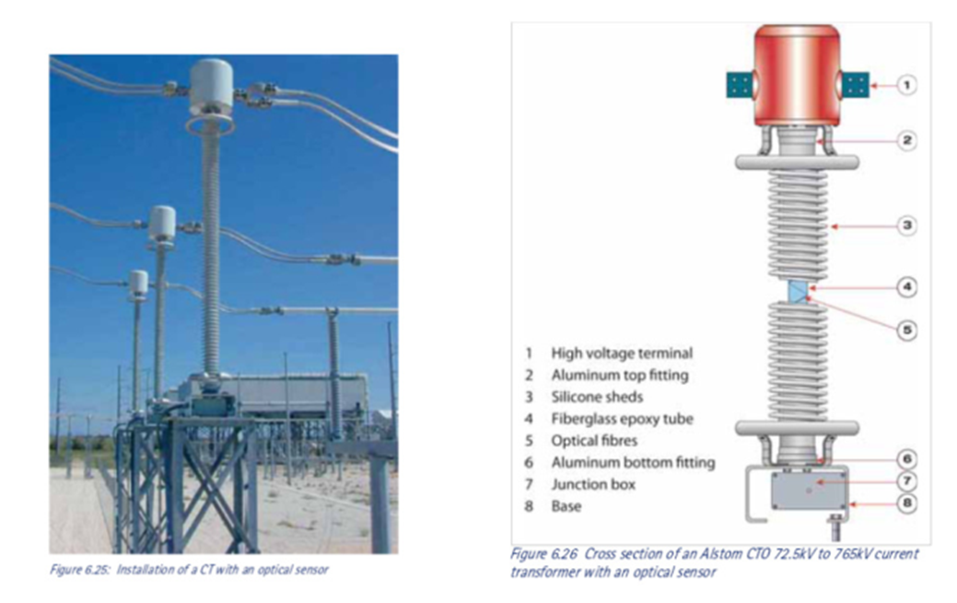
CT

Slide 20
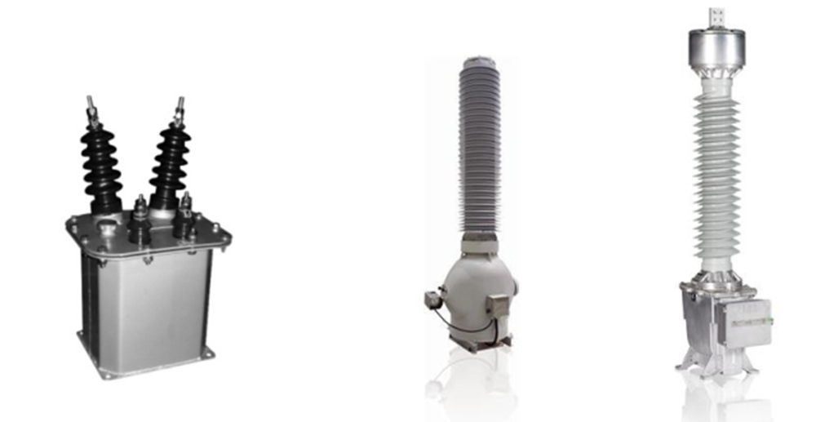
PT

Slide 23
Relay IED
Modern relay IEDs combine a number of different protection functions with measurement, recording and monitoring. For example, the relay IED shown in Figure 6.12 has the following protection functions:

Slide 24
three-phase instantaneous over-current: Type 50 (IEEE/ANSI designation);
three-phase time-delayed over-current (IDMT): Type 51;
three-phase voltage controlled or voltage restrained instantaneous or time-delayed overcurrent: Types 50V and 51V;
earth fault instantaneous or time-delayed over-current: Types 50N and 51N

Slide 25
Various algorithms for different protection functions are stored in a ROM. For example, the algorithm corresponding to Type 50 continuously checks the local current measurements against a set value (which can be set by the user or can be set remotely) to determine whether there is an over-current on the feeder to which the circuit breaker is connected.

Slide 26
If the current is greater than the setting, a trip command is generated and communicated to the Circuit Breaker (CB). IEDs have a relay contact that is hard-wired (in series) with the CB tripping coil and the tripping command completes the circuit, thus opening the CB.

Slide 27
Meter IED
A meter IED provides a comprehensive range of functions and features for measuring threephase and single-phase parameters. A typical meter IED measures voltage, current, power, power factor, energy over a period, maximum demand, maximum and minimum values, total harmonic distortion and harmonic components

Slide 28
Recording IED
Even though meter and protection IEDs provide different parameters (some also have a data storage capability), separate recording IEDs are used to monitor and record status changes in the substation and outgoing feeders.

Slide 29
Bay controller
Bay controllers (Figure 6.14) are employed for control and monitoring of switchgear, transformers and other bay equipment. The bay controller facilitates the remote control actions (from the control centre or from an on-site substation control point) and local control actions (at a point closer to the plant)

Slide 30
The functionalities available in a bay controller can vary, but typically include:
CB control
switchgear interlock check
transformer tap change control
programmable automatic sequence control.

Slide 32
Components for fault isolation and restoration
Whenever there is a fault on a part of the distribution network, the fault current should be interrupted rapidly,
the faulted section isolated from the healthy network and, then once the fault has been removed, supplies to customers should be restored.
This is achieved through a range of equipment generally known as switchgear

Slide 33
The term switchgear includes: a circuit breaker which is capable of making and breaking fault currents,
a recloser which is essentially a CB with a limited fault-breaking capacity and variable pattern of automatic tripping and closing, a switch disconnector which has a limited fault-making capability(and which is capable of making and breaking normal load current), and a sectionaliser which is capable of making and breaking normal load current but not the fault current.

Slide 34
33 kV substation switchgear may be located inside the substation building or in an outdoor high voltage compound;
whereas 11 kV substation switchgear is normally indoor type or mounted on the overhead line poles.
The protection and metering equipment of substation switchgear is housed inside the substation control room. Out on 11 kV circuits, away from primary substations, switchgear is usually outdoors, often as a Ring Main Unit.

Slide 35
A typical RMU consists of two switch-disconnectors and a switch-fuse2 or circuit breaker (Figure 6.16).

Slide 37
In the past, switch-disconnectors in an RMU required manual operation but automatic operation can now be achieved for these designs by retrofitting an actuator mechanism.
The most commonly used retrofit actuator mechanism is a motor wound spring. Remote switching is initiated from a field RTU3 as shown in Figure 6.17. For clarity, only switch-disconnectors are shown in Figure 6.17.
In modern switchgear, instead of a motor wound spring, compressed gas or magnetic actuators are increasingly used

Slide 39
Most overhead line faults are transient and self-clearing once the circuit is de-energised.
Hence either auto-reclose of the substations CBs or a self-controlled recloser, which can perform a variable pattern of tripping and reclosing, is used on many overhead distribution circuits.
These will prevent unnecessary sustained outages for temporary faults

Slide 40
The upper sequence of Figure 6.18 shows how a recloser clears a temporary fault after two recloses. The purpose of the delayed tripping (see the lower sequence of Figure 6.18) is if the fault is permanent, the delay allows sufficient current (and time) to pass through the downstream fuse so as to clear the fault

Slide 42
Pole-mounted reclosers are widely used in distribution circuits. They have different voltage ratings (for example, 11, 15, 33 kV) and interrupting currents of 8 to 16 kA. The energy required to operate the reclosing arrangement is provided by a solenoid as shown in Figure 6.19
In this arrangement, whenever the line current is high (due to a fault), the series trip coil opens the vacuum CB. As the CB is opened, the auxiliary contacts are closed automatically, thus providing energy for the reclosing operation

Slide 44
An RTU can be incorporated with a pole-mounted recloser for remote switching and changing its settings remotely (see Figure 6.21, also refer to Plate 2). In the USA, alternative trip settings are used during storms to save the fuses as it is difficult to reach remote areas for fuse replacement.

Slide 46
A sectionaliser is an automatic isolator which can only be used to isolate a section of a distribution circuit once a fault is cleared by an upstream recloser. When the recloser opens, self-powered control circuit in the sectionaliser increments its counter. The recloser is reclosed after a short delay to see whether the fault is temporary.

Slide 47
If the fault is temporary and cleared by the recloser, the sectionaliser resets its counter and comes back to its normal state. However,
if the fault is permanent, when the number of counts in the sectionaliser reaches a pre-defined number, it opens and isolates the downstream section of circuit.

Slide 48
If the fault is downstream of the sectionaliser, the recloser then restores supply to the upstream section. This minimises the number of consumers affected by a permanent fault, and a more precise indication of the fault location is provided

Slide 49
Fault location, isolation and restoration

Slide 50
First case
Figure 6.24 shows a typical 11 kV distribution network. When there is a fault on the network at the location shown, the over-current protection element in IED1 detects the fault and opens CB1.
This will result in an outage at loads L1 to L5. Since there are no automated components in the network, supply restoration for a part of the network requires the intervention of a restoration crew and in some areas may take up to 80 minutes

Slide 51
Supply restoration is normally initiated by phone calls from one or more customers (in the area where outage occurred) reporting a loss of supply to the electricity supplier. Upon receiving these calls a restoration crew is dispatched to the area. It will take some time for the team to locate the fault and manually isolate it by opening SD3 and SD4.
Then CB1 is closed to restore the supply to L1, L2 and L3. The normally open point (NOP) is closed to restore the supply to L5. Load L4 will be without supply until the fault is repaired.

Slide 52
Second Case:
A simple method to reduce the restoration time of loads L1, L2, L3 and L4 is using a pole-mounted recloser and sectionaliser as shown in Figure 6.25. When a fault occurs, the recloser trips. Upon detecting the interruption, the sectionaliser, S, increments its counter by 1.

Slide 53
After a short time delay, the recloser closes and if the fault persists, it will trip again. The counter of S increments again and it is then opened. The recloser then closes successfully.
The operation of the sectionaliser facilitates restoration of supply to L1, L2, L3 and L4 within a couple of minutes. However, the restoration of supply to L5 requires the intervention of the crew.

Slide 55
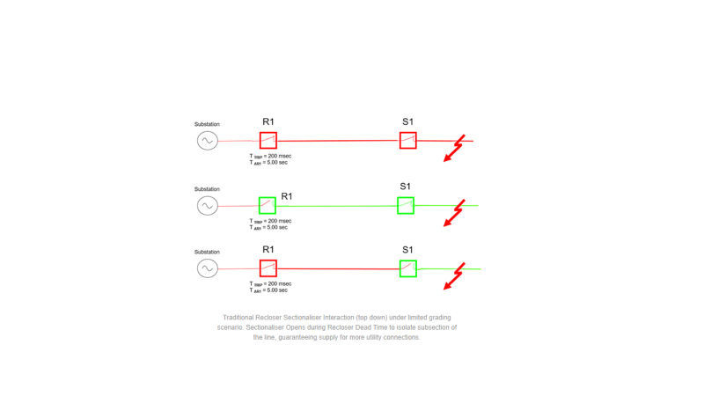

Slide 56
Third case:

Slide 57
A greater degree of automation may be introduced by using reclosers with RTUs, with communication infrastructure between them (see Figure 6.26). In this scheme, an Agent is employed that gathers data from all the intelligent devices in the system.
During normal operation, the Agent polls all the RTUs and IEDs to establish the system status. When there is a fault at the location shown, IED1 detects the fault current, opens the CB and informs the Agent.
The Agent sends commands to RTU1 to RTU4 (remote terminal units up to the normally open point) to open them and requests current and voltage data from them in real time

Slide 58
1. Send a command to IED1 to close CB1.
2. Send a command to RTU1 to reclose R1. If the fault current prevails, initiate a trip but as there is no fault current, R1 remains closed. Similarly send commands to RTU2, 3 and 4 to reclose R2, R3 and R4. When R3 is closed, fault current flows, thus causing R3 to trip and lock-out.
3. Then send a command to RTU9 to close the normally open point.
4. Finally, send a command to RTU4 to close R4. As the fault current flows, a trip command is initiated for R4. R3 and R4 thus isolate the fault and supply is restored to loads L1, L2, L3 and L5.

